Slide 1



Quantum Computing for the Quantum Curious
1.0 Superposition

Slide 2



1.0 Objectives
• Explain what it means for an object to be in a quantum superposition.
• Identify the measurement outcome of a system in a classical vs. quantum superposition.
Key Terms: quantum system, quantum state, quantum superposition

Slide 3
1.1 Classical Superposition
In classical physics, the principle of superposition is used to describe how physical quantities can be combined to form new quantities.
This principle is evident in wave interactions and the calculation of forces.

Slide 4
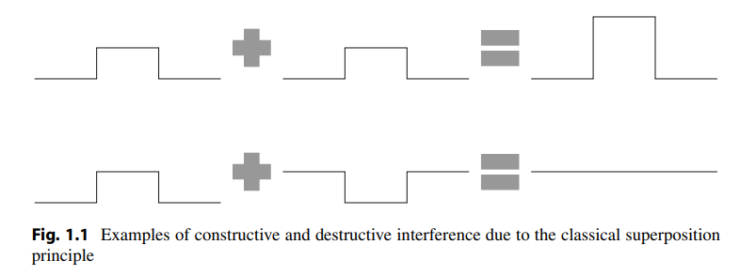
1.1 Classical Superposition
Example: Wave Interference
When two waves interact, their amplitudes add together according to the principle of superposition. This interaction can result in constructive or destructive interference:
Constructive Interference: When two waves meet in phase, their amplitudes add up, creating a larger wave.
Destructive Interference: When two waves meet out of phase, their amplitudes cancel each other out, reducing the overall wave amplitude.

Slide 5

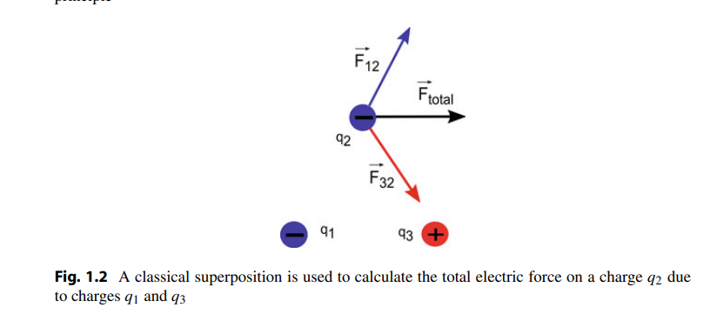
1.1 Classical Superposition
Example: Vector Addition
Finding the total magnitude and direction of quantities such as force, electric field, magnetic field,etc.
In classical mechanics, forces are vectors and follow the principle of superposition. To calculate the total force on a charge q_2​ due to other charges q_1​ and q_3​, one must sum the individual forces vectorially:

Slide 6
1.2 Quantum Superposition
Quantum superposition is a fundamental concept in quantum mechanics, where a quantum system can exist in multiple states simultaneously until it is measured.
We Will Be going through:
Energy Quantization
Coin Toss Analogy
Schrödinger's Cat

Slide 7
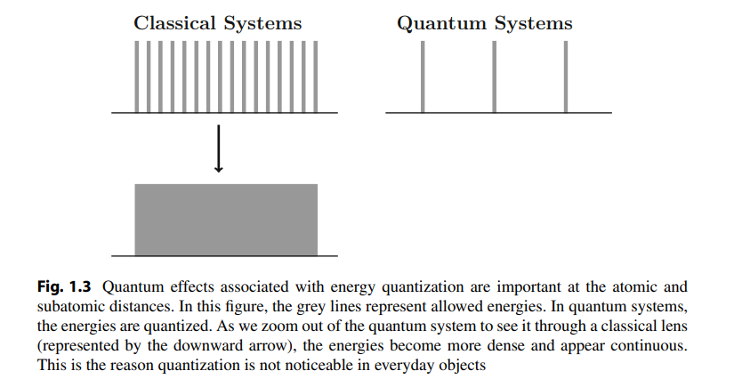
1.2 Quantum Superposition
Energy Quantization
In classical physics, energy can take any value within a range. For example, you would normally expect that an object can have an arbitrary amount of kinetic energy ranging from 0 to infinity (∞) Joules, i.e. a baseball could be at rest or thrown at any speed. However, according to quantum mechanics, the ball’s energy is quantized, meaning it can only have certain values.
A specific example of energy quantization is when energies can only have integer values E = 0, 1, 2, 3,..., but not any numbers in between. This is counterintuitive, as we cannot observe it with our classical eyes. The gaps in energy are too small to be seen with the human eye and as such can be treated as continuous for classical physics.

Slide 8
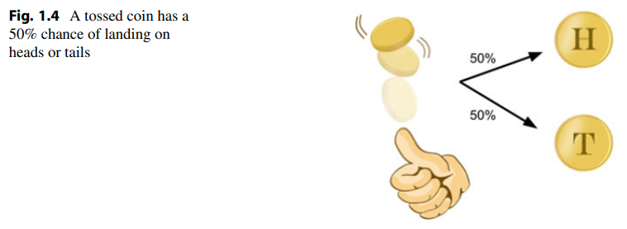
1.2 Quantum Superposition
Coin Toss Analogy
One aspect of quantum superposition can be explained using a coin analogy.
Question 1 What state is the coin in while it is in the air? Is it heads or tails?
While it is in the air: We can say that the coin is in a superposition of both states (heads and tails). When it lands (Measured), it has a definite state, either heads or tails
When we observe the coin, we are making a measurement which destroys the superposition to a definite quantized values (either in a heads state or a tails state).

Slide 9

1.2 Quantum Superposition
Schrödinger's Cat
In Schrödinger’s famous thought experiment, Schrödinger’s cat is placed in a closed box with a single atom that has some probability of emitting deadly radiation at any time. Since radioactive nuclear decay is a spontaneous process, it is impossible to predict for certain when the nucleus decays. Therefore, you do not know whether the cat is alive or dead unless you open and look in the box.
Video:
Schrödinger's Cat

Slide 10
1.3 Big Ideas
1. A particle in a quantum superposition exists as a combination of different states at the same time.
2. Each possible state has a given probability of being observed, but measurement destroys the superposition because only one definite state is seen.

Slide 11
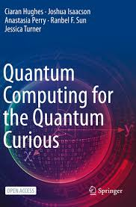
Reference Book
Quantum Computing for the Quantum Curious
This open access book makes quantum computing more accessible than ever before. A fast-growing field at the intersection of physics and computer science, quantum computing promises to have revolutionary capabilities far surpassing “classical” computation. Getting a grip on the science behind the hype can be tough: at its heart lies quantum mechanics, whose enigmatic concepts can be imposing for the novice. This classroom-tested textbook uses simple language, minimal math, and plenty of examples to explain the three key principles behind quantum computers: superposition, quantum measurement, and entanglement.
Hughes, C., Isaacson, J., Perry, A., Sun, R. F., & Turner, J. (2021). Quantum computing for the quantum curious. In Springer eBooks. https://doi.org/10.1007/978-3-030-61601-4

